Slide 1
C# API Programming
2019.5.25
https://www.youtube.com/watch?v=aWePkE2ReGw

Slide 2
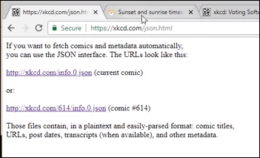
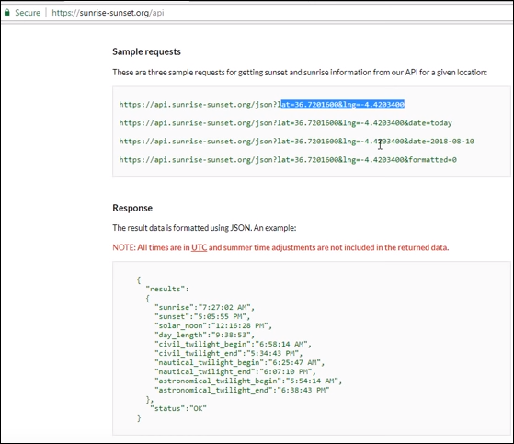
Xkcd.com
Sunrise-sunset.org/api

Slide 3
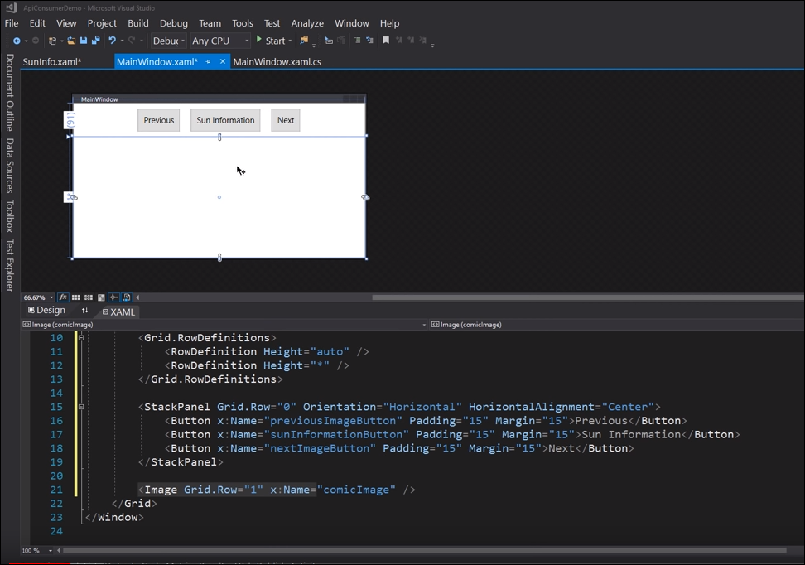

Slide 4
